Slide 1
Latest models and tasks
Ali Hürriyetoğlu
SICSS-Istanbul
July 4, 2023

Slide 2
BERT
Pre-training of Bidirectional Transformers for Language Understanding

Slide 3
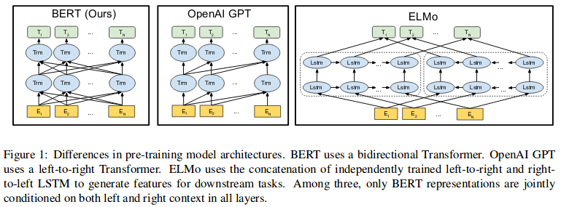
BERT - Architecture
Notes:
Pretraining and sharing the was done before BERT, but it achieved it to a greater extent.
Talk about differences of architecture. GPT is geared towards generation, ELMO suffers from limitations of RNNs.

Slide 4
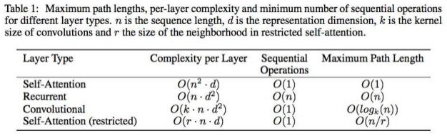
Transformer - Motivation
Problems with Recurrent Neural Networks (RNNs)
Sequential computation prevents parallelization
Despite GRUs and LSTMs, RNNs still need attention mechanisms to deal with long range dependencies.
Notes:
Parallelization allows scaling the models to a greater extent.
Self-attention’s complexity is dependent on sequence length, so they limit it. But it allows us to represent the input in greater dimensions.

Slide 5
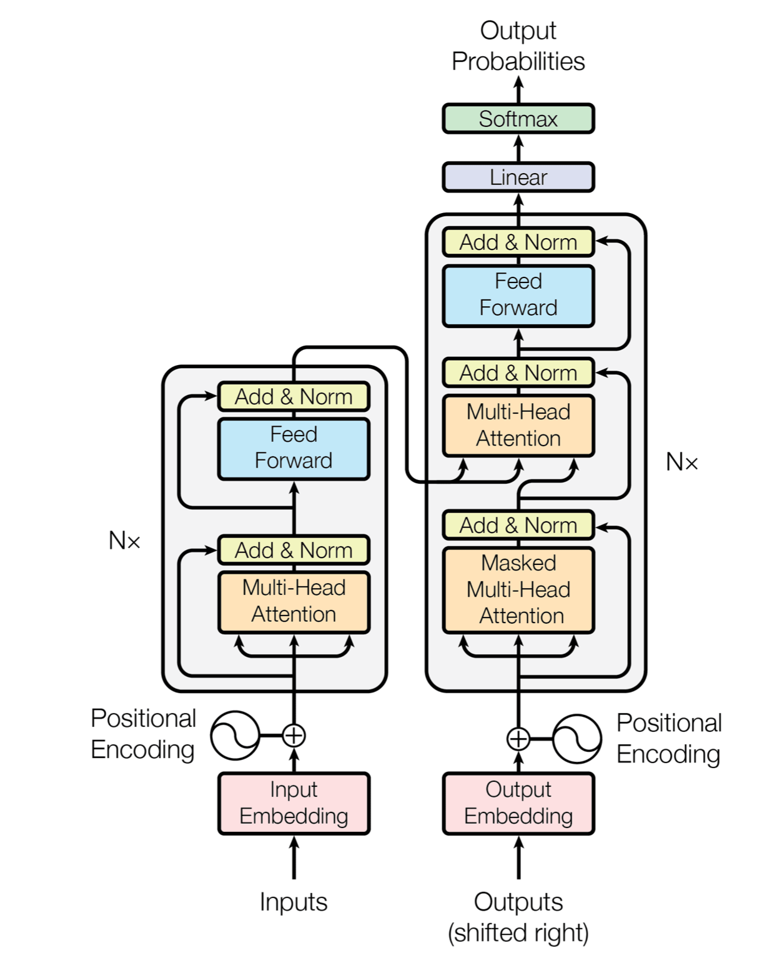
Transformer - General Architecture
Built to be used in machine translation
Sequence to sequence
Encoder-Decoder
Uses stacks of layers
Self Attention mechanism
Adding residual for each sublayer after dropout and layer normalization
Positional embeddings are calculated linearly using sine and cosine transformations
Feed forward hidden size is 4 * model_size

Slide 6
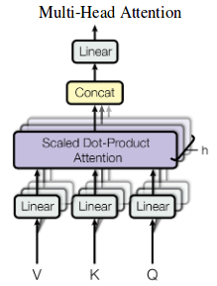
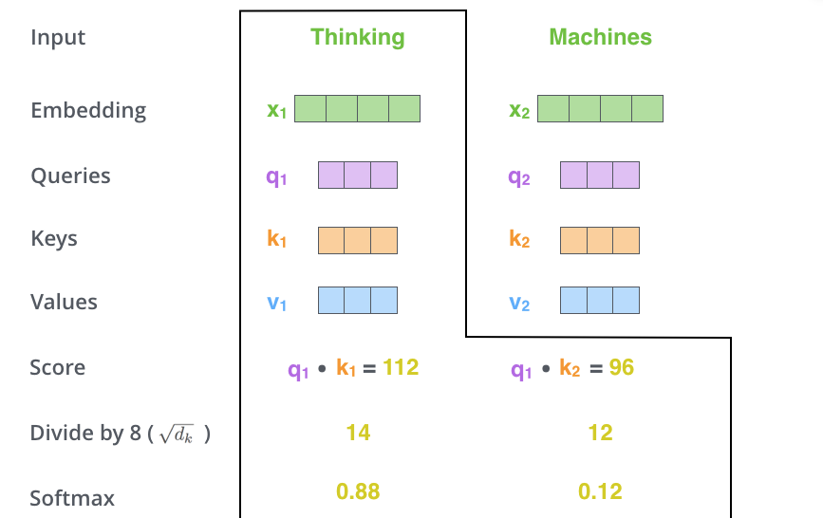
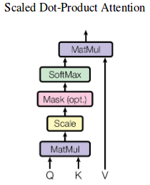
Transformer - Scaled Dot Product Attention
Query, Value and Key matrices are the size of seq_len x (model_size/h)
Each head has different weights for linear transformations of the input to V, K, Q matrices
Scaling is done by dividing with square root of (model_size/h)
Notes:
Although we can analyze what each token goes through, all tokens are going through self-attention mechanism in parallel.

Slide 7
BERT - General Info
Inputs are summed up token, segment and position embeddings
Input consists of two sentences. First token is CLS and there is a SEP tag after each sentence
Trained on BooksCorpus (800M words) and Wikipedia (2,500M words)
Bert-Base L=12, H=768, A=12, Total Parameters=110M. Bert-Large L=24, H=1024, A=16
Has two unsupervised prediction tasks : Masked LM And Next Sentence Prediction
Maximum sequence length is 512. Batch size is 256.
Uses gelu activation at the end
Loss is sum of mean Masked LM loss and mean NPS loss.
256 x 512 for 1M steps =~ 40 epochs over 3.3 billion word corpus.
Notes:
BERT uses the encoding part of the transformers.

Slide 8
BERT - Pre-training Tasks
Masked LM
Masking %15 of the input and only predicting the masked tokens (%80 is masked, %10 is replace randomly, %10 is not replaced)
The transformer encoder does not know which words it will be asked to predict or which have been replace by random words, so it is forced to keep a distributional contextual representation of every input token
Only %15 of the tokens are predicted in each batch, so more pre-training steps are required
Next Sentence Prediction
When choosing the sentences A and B for each pre-training example, %50 of the time B is the actual next sentence, and %50 of the time it is a random sentence from the corpus

Slide 9
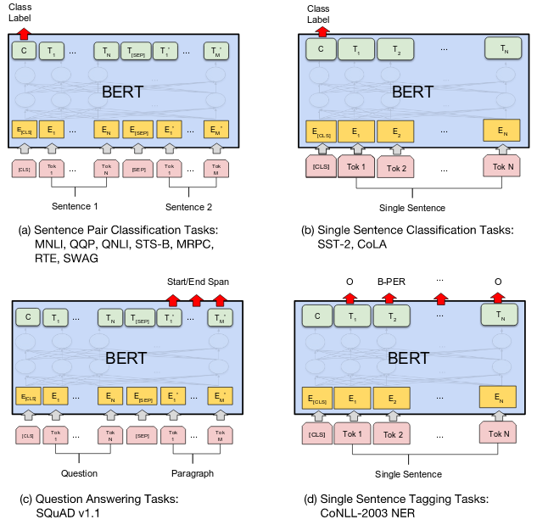
BERT - Fine-tuning
For a pooled representation of the input sequence, they take the output of final Transformer from the first token which is the special CLS token. They apply softmax after a linear transformation W.
They fine tune this W jointly with whole model.
Batch size is 16, 32 , Epochs = 3, 4
Notes:
This part is nothing new, it is just to show how to use this pre-trained model for finetuning. Like I said, pretraining was already a thing before BERT.

Slide 10
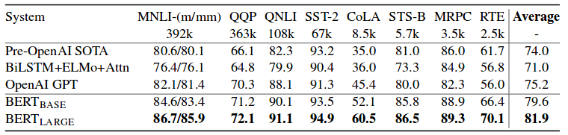
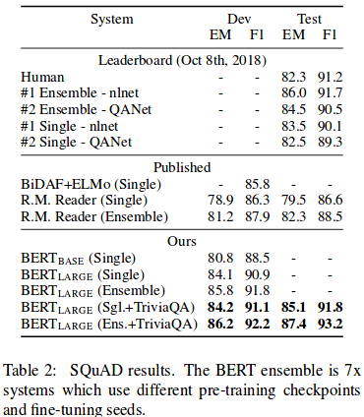
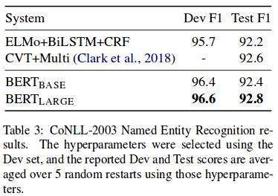
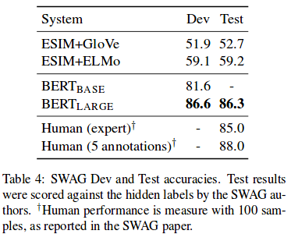
BERT - Results
Notes:
Huge jump in performance convinced most researchers to focus on Transformers.

Slide 11
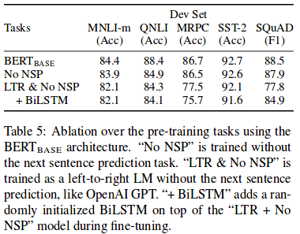
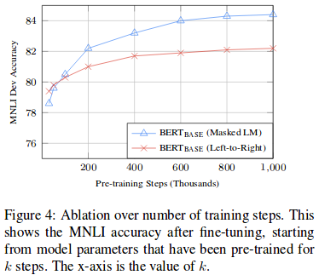
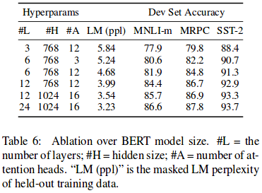
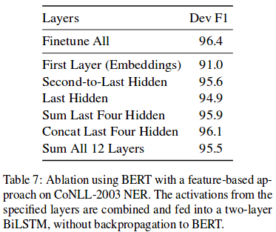
BERT - Ablation Studies
Notes:
Some practical information from the BERT paper.

Slide 12
BERT - Conclusion
BERT is everywhere
While it introduced some limitations, it greatly enabled scaling
Due to its robustness, sharing pre-trained models became more popular.
Many variants, extensions have been proposed by large players (Google, Facebook, OpenAI, etc.)

Slide 13
Thanks for listening!
What questions do you have?
Reach me at: ali.hurriyetoglu@gmail.com

